Slide 1
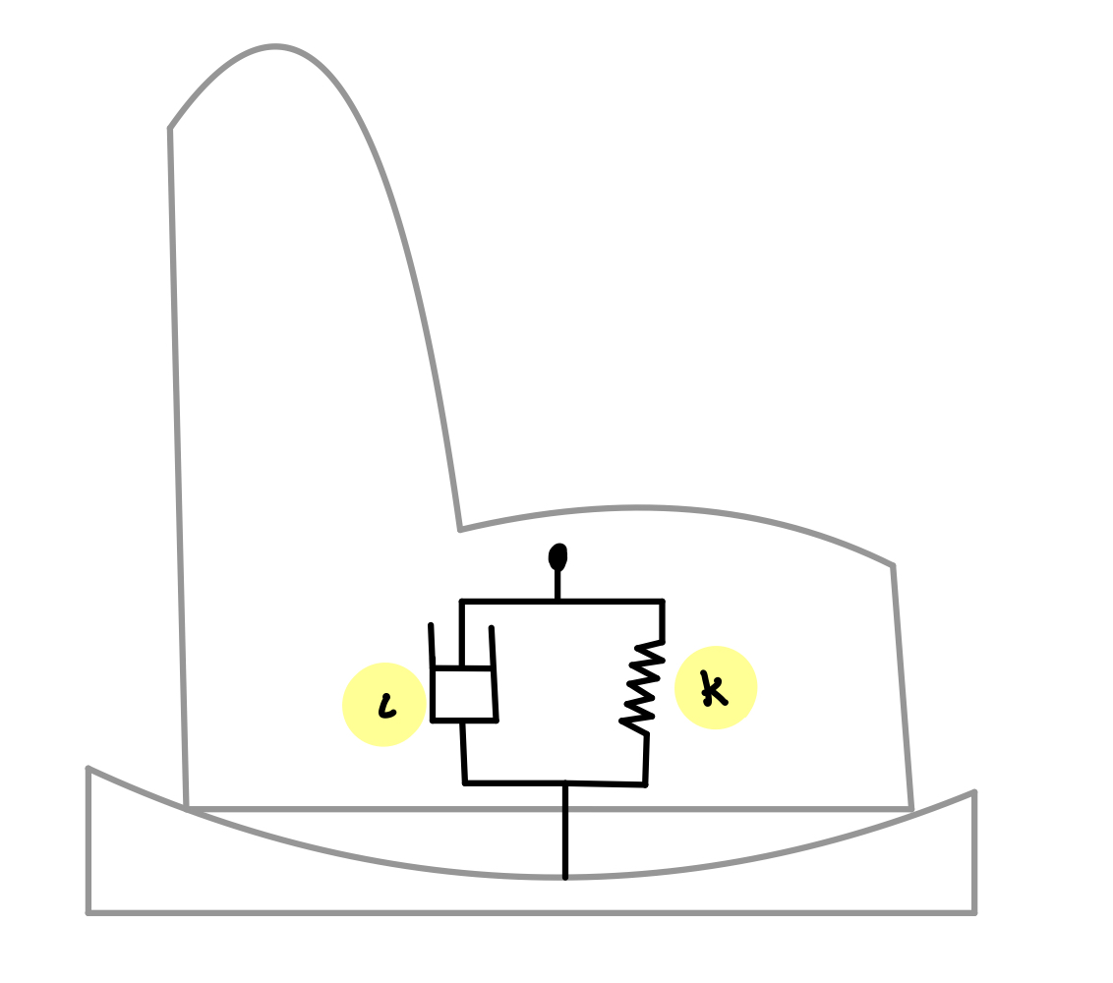
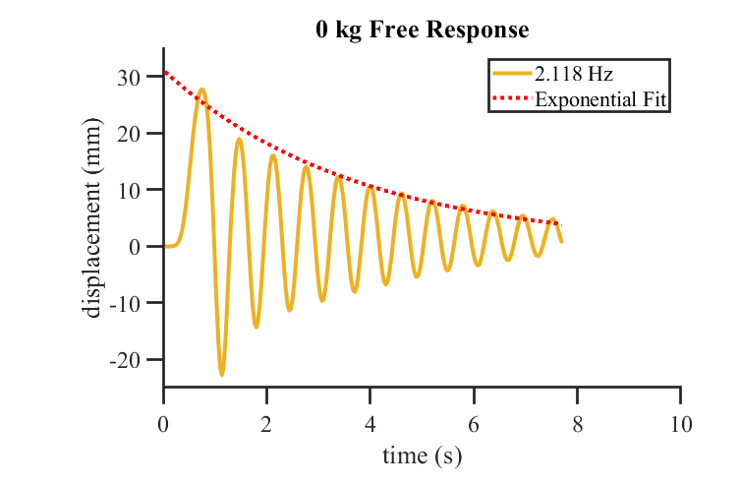
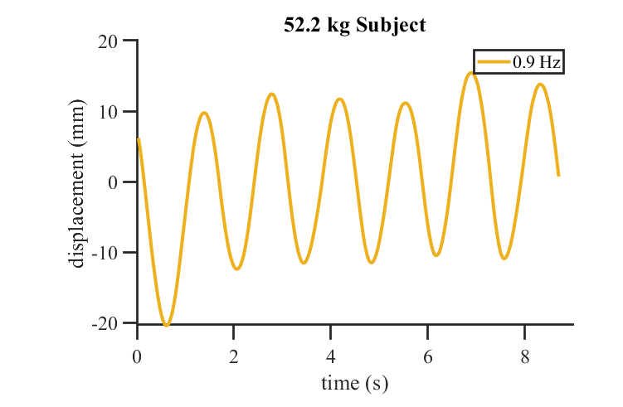
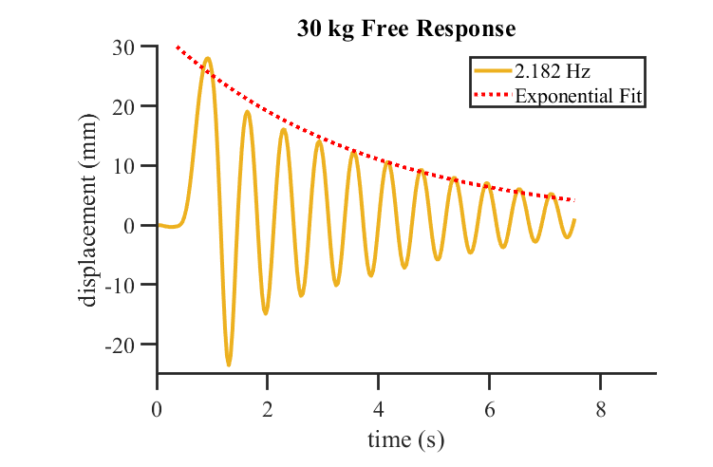
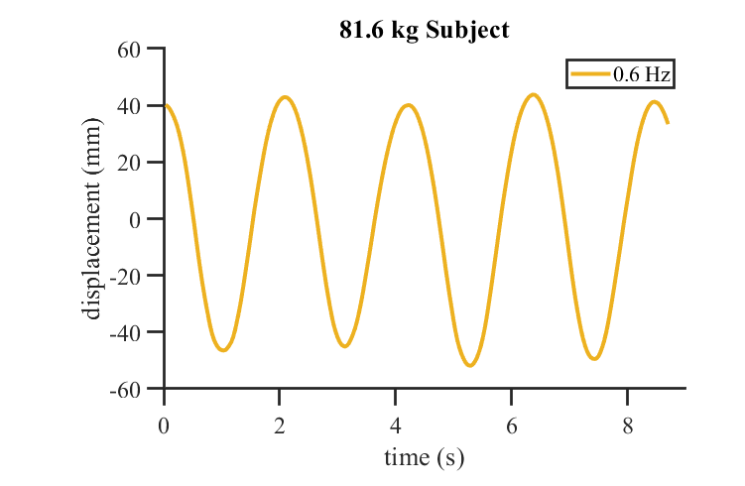
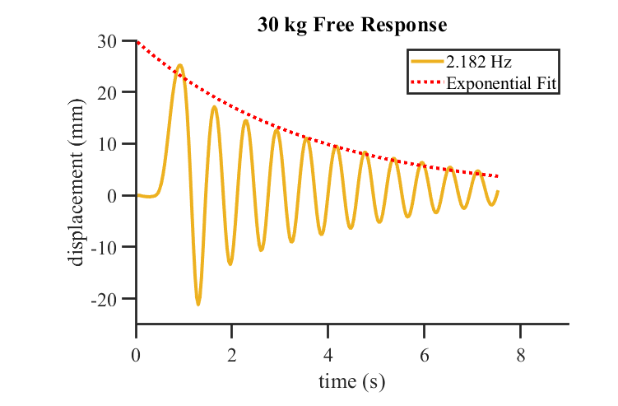
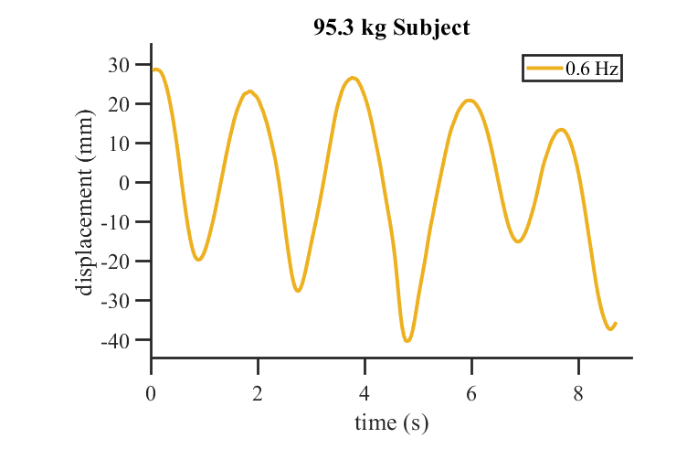
Finding Orange: Natural Frequency of Rocking Chairs Vivian Bernard, Taiwo Sogbesan, Stephen Hugo Arce PhD Department of Chemical and Biomedical Engineering
Background
Children with autism spectrum disorder often have difficulty falling asleep unless they feel secure. Common reclining chairs are often used to rock these children to sleep, providing motion and security; however, if a child wakes at night, they may not be able to rock themselves back to sleep. The goal of our project was to create an automatic rocking chair for a local child suffering from sleep difficulties. To ensure that the device would be comfortable, the rocking amplitude and frequency must be determined.
Discussion
Free oscillation of an underdamped mass spring damper system follows:
The solution to this equation is:
where α and w₀ represent the roots of the characteristic equation, found using the quadratic formula:
Forced oscillations, on the other hand, follow:
The solution to this system is:
which is a combination of the free response and the forced response.
Diagram 1: Model of Rocking Chair (mass) with spring and damper (left). Video frame from motion tracking featuring bright orange stickers (above left). Video frame after processing in MATLAB to find the orange pixels and their corresponding centroids (above right). The vertical position of these centroids was further analyzed.
Methods
The key activity of our project was to test and record the motion of a conventional recliner chair under free oscillation and forced oscillation as a subject rocked comfortably. We recorded subjects rocking back and forth in the chair for approximately 30 seconds using a conventional smartphone. Along the side of the chair were 3 orange stickers located in different positions which could easily be tracked using video analysis because of their bright color. The motion of each sticker was then extracted to analyze their motion and extract the frequency and amplitude of comfortable rocking motion.
Figure 1: Free-Motion with 0 kg
Figure 2: Forced-Motion with 52.2 kg Subject
Future Plans
The goal of the project was to create a rocking device to meet the needs of the autistic child who struggles to get adequate sleep. Our research has provided the technical specifications for our device to ensure that it will be comfortable for the subject. The proposed rocking device will be designed in CAD and constructed leveraging 3D printing and an Arduino microcontroller.
MATLAB
The data was processed using MATLAB. In each video frame, the pixels corresponding to the stickers were segmented and their centroids were determined. The vertical position of each sticker was plotted versus time and the peaks of the oscillations were found and fit to an exponential decay for free oscillations. The frequency of rocking was determined by analyzing the time between oscillation peaks.
Figure 3: Free-Motion with 13.6 kg Trial 1
Figure 4: Forced-Motion with 81.6 kg Subject
References ​​
S. Baek, et al. “Effect of a Recliner Chair with Rocking Motions on Sleep Efficiency.” Sensors (Basel, Switzerland) 21.24 (2021): 8214. https://doi.org/10.3390/s21248214 (Retrieved March 3, 2022)​
G. Durán-Pacheco, et al. “Effect of Children’s Autism Spectrum Disorder Severity on Family Strain and Sleep Quality: A Cross-Sectional Online Survey in the U.S.” J Autism Dev Disord (2022). https://doi.org/10.1007/s10803-022-05457-7 (Retrieved March 3, 2022)
Acknowledgments
Undergraduate Research Opportunity Program
Colton McGarraugh
Figure 5: Free-Motion with 13.6 kg Trial 2
Figure 6: Forced-Motion with 95.3 kg Subject

